Slide 1
Notes:
Kim

Slide 2
Welcome!
Notes:
Donna

Slide 3
Special Thanks to:
Notes:
Donna

Slide 4
General Membership Meeting May 11, 2022
Opening Remarks
Donna Kreis
Finance Report
Monica Worrell
Grant Committee Report
Sara Burley / Sarah Ortiz-Brown
Members’ Choice Award Update
Terri Garland
Membership and Outreach Committee Report
Donna Kahoe
Closing Remarks
Bonnie Miranda
Notes:
Donna

Slide 5
2021-2022 Executive Board
Donna Kreis
Chair
Bonnie Miranda
Vice-Chair and Secretary
Monica Worrell
Treasurer
Kim Malat
Past Chair
Notes:
Donna

Slide 6
2021-2022 Committee Chairs
Grant Committee Co-Chairs
Sara Burley
Sarah Ortiz-Brown
Membership and Outreach Committee Co-Chairs
Allison Cuneo
Donna Kahoe
Notes:
Donna

Slide 7
2021-2022 Committee Chairs
Members’ Choice Award Committee Chair
Terri Garland
Notes:
Donna

Slide 8
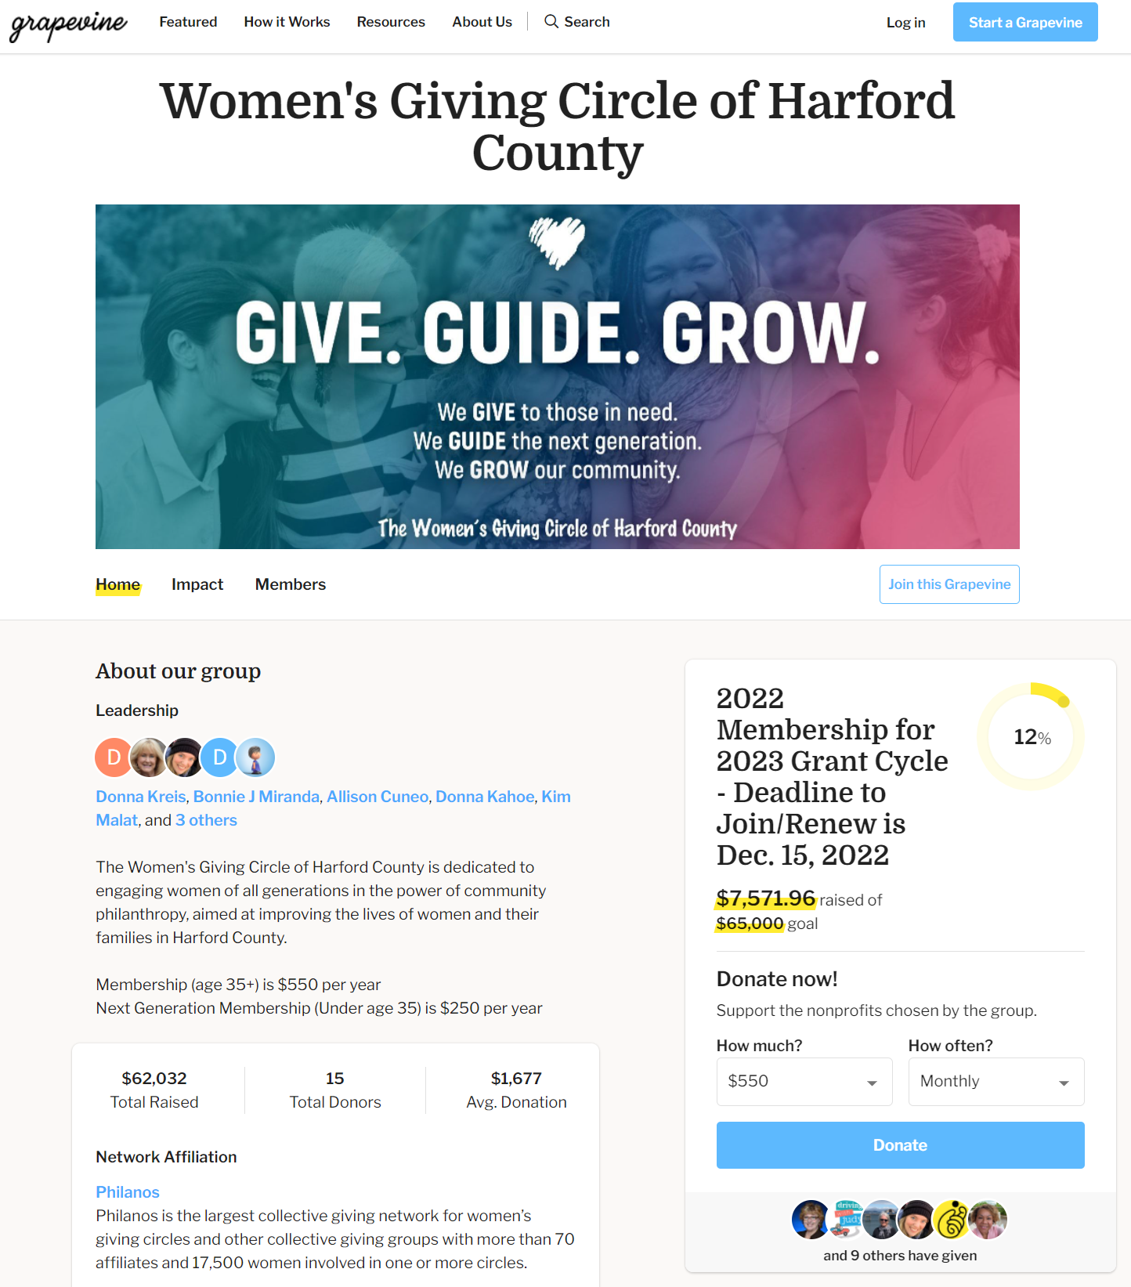
Administrative Updates
Grapevine:
New grant fund platform
One transaction for membership
Checks and payments from donor-advised funds accepted
Matching donations
Notes:
Donna
Matching Donations:
May Madness
It's May Madness! For every 10 NEW donors to your group, we'll add $100 up to $500!

Slide 9
Administrative Updates
Refreshed website
Handouts
Grantee poster
Notes:
Donna

Slide 10
Help Wanted
New Executive Board in January 2023
Committees
Membership and Outreach
Grant
Events
Photography / Video
Notes:
Donna

Slide 11
Circle Update – Grants to Date
11 Years
$450,222.36
134 Grants
56 Nonprofits serving women, families, and children in Harford County
Notes:
Donna

Slide 12
Finance Report
Monica Worrell
Notes:
Donna to Introduce Monica

Slide 13
Fund Balances
$159,517.18 Endowed Fund (as of 02/2022)
$5,517.28 for 3rd Members’ Choice Award
$54,460.50 Grant Fund for 2022 (official balance)
$7,571.96 Grant Fund for 2023 (as of 5/2/2022)*
$3,030.45 Administrative Fund (as of 5/3/2022)*
* Unofficial balance, subject to reconciliation
Notes:
Monica

Slide 14
BONUS GIVING $$$$$$$ 2021/2022 Sponsorships and Donations
Increases Grant Pool & Reduces Expenses
Received to date:
$2,240 Gifts to Administrative Fund
$2,136 Gifts to Grant Fund
$150 Grapevine Matching Gifts to Grant Fund
Notes:
Monica

Slide 15
Grant Committee Report
Sara Burley
Sarah Ortiz-Brown
Notes:
Monica introduce Sara and Sarah

Slide 16
2022 Grant Year Timeline
January 14 – Guidelines and application posted
January 24 – Pre-application meeting for potential applicants
February 4 – Grant Committee kick-off meeting
March 11 – Applications due
March 16 to April 20 – Individual reviews by Committee
April 22 – Grant Committee meeting - discussion and recommendations
April 27 – Recommendations to Board
May 11 – General membership meeting vote on recommendations
June – Notification to grantees, funds disbursed, press release
Notes:
Sara and Sarah

Slide 17
Grant Process
Applications were reviewed and individually scored by Grant Committee members.
The Grant Committee met virtually to discuss the applications as a group and to formulate a slate of recommendations to the Board.
The Board considered the recommendations from the Grant Committee and voted to approve.
The proposed grants are now presented to the general membership for approval.
Notes:
Sara and Sarah

Slide 18
Grant Process
Proposed grants approved by the general membership are submitted to Grapevine.
Grant agreements are executed and publicity photos are taken.
Grapevine issues the award.
Grantees are formally recognized at the General Membership Meeting on September 14, 2022.
Notes:
Sara and Sarah

Slide 19
Recommendations for 2022
Notes:
Sara and Sarah

Slide 20
Chesapeake Therapeutic Riding
Safe Hearts at CTR 2022
$3,188
Will cover the cost for 2 onsite automated external defibrillators (AEDs) & 1 pediatric pack.
Notes:
Sara and Sarah

Slide 21
Ed Lally Foundation Inaugural Harford County Women's Mindfulness Retreat
$2,000
Supports mental health & suicide prevention for 30 women. The funds will be used to support staff in the development and administration of the retreat and day of event expenses - location, materials, and food. They will host a virtual monthly support group throughout the following year until the next retreat in 2023.
Notes:
Sara and Sarah

Slide 22
Edgewood Community Support Center
Case Management
$5,000
Support for the case manager’s salary. The case manager connects individuals facing challenges due to financial, physical, and/or mental health issues with resources in the community at their new, second location, in Aberdeen.
Notes:
Sara and Sarah

Slide 23
Found in Faith Ministries
Transportation Scholarship Applicants
$3,200
Found in Faith Ministries seeks to increase funding available for their Transportation Scholarship applicants. They anticipate being able to serve approximately 24 more Harford County families, increasing their service provision by 10-15% with the support of the WGC.
Notes:
Sara and Sarah

Slide 24
Girls on the Run
$3,000
An emotional support training program for girls ages 8-13. We will fund everything needed for one season for up to 15 girls.
Notes:
Sara and Sarah

Slide 25
Habitat for Humanity Susquehanna
Empowering Women Through Shelter
$5,000
Grant funds will be used towards construction costs for homes in Havre de Grace – the last duplex in the Revolution/Stokes community and a duplex on Erie Street.
Notes:
Sara and Sarah

Slide 26
Harford County Education Foundation
Littles University
$3,500
HCEF has partnered with Harford County Public Schools to form “Littles University.” HCPS will release a video reading of an age-appropriate book and parents and children tune-in to participate in the reading on a monthly basis. In addition, HCEF ships the featured book to 250 children (birth to 5 years) each month.
Notes:
Sara and Sarah

Slide 27
Harford Family House
Child Care
$3,000
This funding will enable Harford Family House to provide direct financial assistance to families experiencing homelessness to address their childcare needs through a partnership with the Boys & Girls Clubs and local daycare providers. Services will be mostly in Aberdeen and along the Rt 40 corridor.
Notes:
Sara and Sarah

Slide 28
Homecoming Project
Life Skills Group
$3,500
Requesting WGC funding as part of the ongoing expense of shelter support, but specifically to cover the cost of 20 weeks of a life skills group.
Notes:
Sara and Sarah

Slide 29
Humanim, Inc.
Infinity Center for Behavior Services of Harford County
$5,000
Humanim is requesting funds to assist with the purchase of therapy equipment and reinforcers. The therapy equipment/reinforcers they utilize to engage and educate children is at the crux of ABA therapy. Examples of equipment include puzzles, play kitchen equipment, and play tool benches.
Notes:
Sara and Sarah

Slide 30
LASOS, Inc.
Summer Program "Open up to the Community"
$5,000
LASOS, Inc. hosts an academic and youth development program designed for non-native English speaking students to come to the LASOS office or to meet at their home schools to receive homework support, mentoring, and increase technology skills.
Notes:
Sara and Sarah

Slide 31
Mason-Dixon Community Services
Senior Outreach Program
$3,072.50
The Senior Outreach Program will provide food services as a continuation of a program started during COVID-19. Food services will include an abundance of produce as well as dairy products and frozen meats to seniors throughout their service area on a quarterly basis.
Notes:
Sara and Sarah

Slide 32
Sleep in Heavenly Peace No Kid Sleeps on the Floor in Our Town! - Harford Co. Chapter
$5,000
WGC support of $5,000 will enable the MD-Harford Chapter to purchase necessary supplies and materials to provide 18 (of their one hundred bed goal in 2022) fully furnished twin beds for children without beds in Harford County.
Notes:
Sara and Sarah

Slide 33
TasteWise Kids
Days of Taste at Havre de Grace Elementary School
$5,000
WGC funds will support all costs associated with providing the Days of Taste program at Havre de Grace Elementary School in the Spring of 2023. The program consists of three mornings spaced over 2-3 weeks.
Notes:
Sara and Sarah

Slide 34
2022 Grant Awards Proposed
$54,460.50 to 14 Deserving Applicants (*new recipient)
$3,188 $2,000 $5,000 $3,200 $3,000 $5,000 $3,500 $3,000 $3,500 $5,000 $5,000 $3,072.50 $5,000 $5,000 | Chesapeake Therapeutic Riding, Inc. Ed Lally Foundation* Edgewood Community Support Center (EPICENTER) Found In Faith Ministries Girls on the Run Central Maryland Habitat for Humanity Susquehanna Harford County Education Foundation Harford Family House Homecoming Project Humanim LASOS, Inc. Mason Dixon Community Services Sleep in Heavenly Peace, Inc. TasteWise Kids
Notes:
Sara and Sarah
– ask for questions / discussion

Slide 35
Notes:
Donna

Slide 36
And the Grant Total for 2011 – 2022 Awards Is….
Notes:
Donna

Slide 37
$504,682.86
Notes:
Donna

Slide 38
Members’ Choice Award Update
Terri Garland
Notes:
Donna introduce Terri

Slide 39
Members’ Choice Award
Committee Members
Terri Garland, Chair
Jodi Marschhauser
Kim Malat
Tami Zavislan
Notes:
Terri

Slide 40
Members’ Choice Award
Established in 2020
Distribution from Endowed Fund held by the Community Foundation
2021 Recipient:
Miracle League of Harford County
$4,639.50
Nominated by Julie Chmura
Planning underway for 3rd award
2022 Distribution = $5,517.28
Notes:
Terri

Slide 41
Membership and Outreach Committee Report
“Alone, we can do so little. Together, we can do so much.”
-Helen Keller
Notes:
Terri introduce D2

Slide 42
Membership and Outreach Committee Members
Donna Kahoe & Allison Cuneo, Co-Chairs
Maria Dontas
Terri Garland
Susan Humphries
Rosemary King Johnston
Karen Kukurin
Notes:
D2
Stress importance of membership – members = grants

Slide 43
Membership
On 1/1/22, we had 109 active members
As of 5/11/22, we have 112 active members
6 Next Generation members
2022 Goals:
Reach 140 active members by 12/15/2022
Welcome 30 new members
Notes:
D2
Stress importance of membership – members = grants

Slide 44
The greater our membership, the greater our giving!
Reach out across your personal and professional networks.
Share the impact and power of women’s philanthropy.
Grow the WGC love in 2022!
Do you have a friend, family member, or colleague interested in learning more about our organization?
Introduce us! Copy them on an email to WGCHarfordMembership@gmail.com.
Notes:
D2

Slide 45
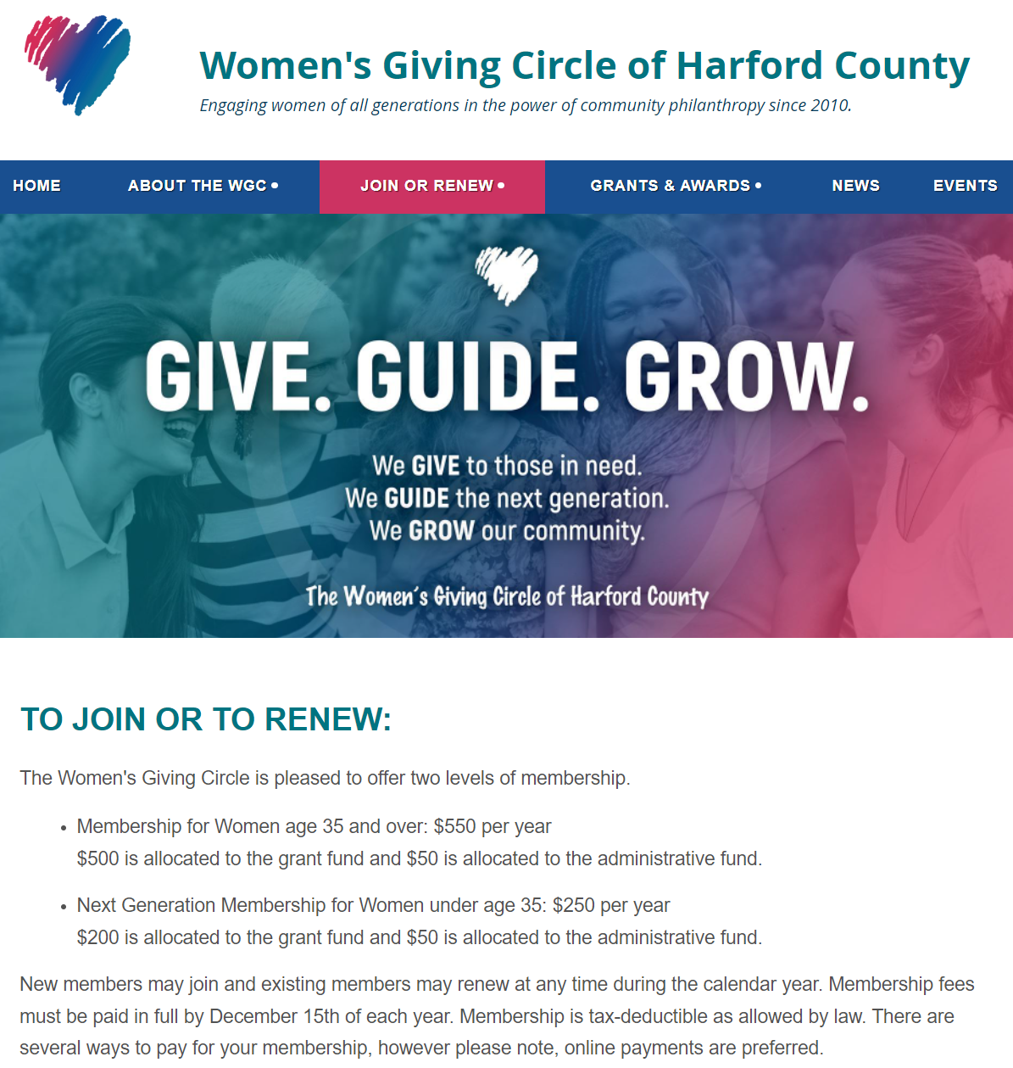
Membership
Two Levels of Membership
Membership for Women age 35 and over
$550 per year
$500 to grant fund
$50 to administrative fund
Next Generation Membership for Women under the age of 35
$250 per year
$200 to grant fund
$50 to administrative fund
Notes:
D2

Slide 46
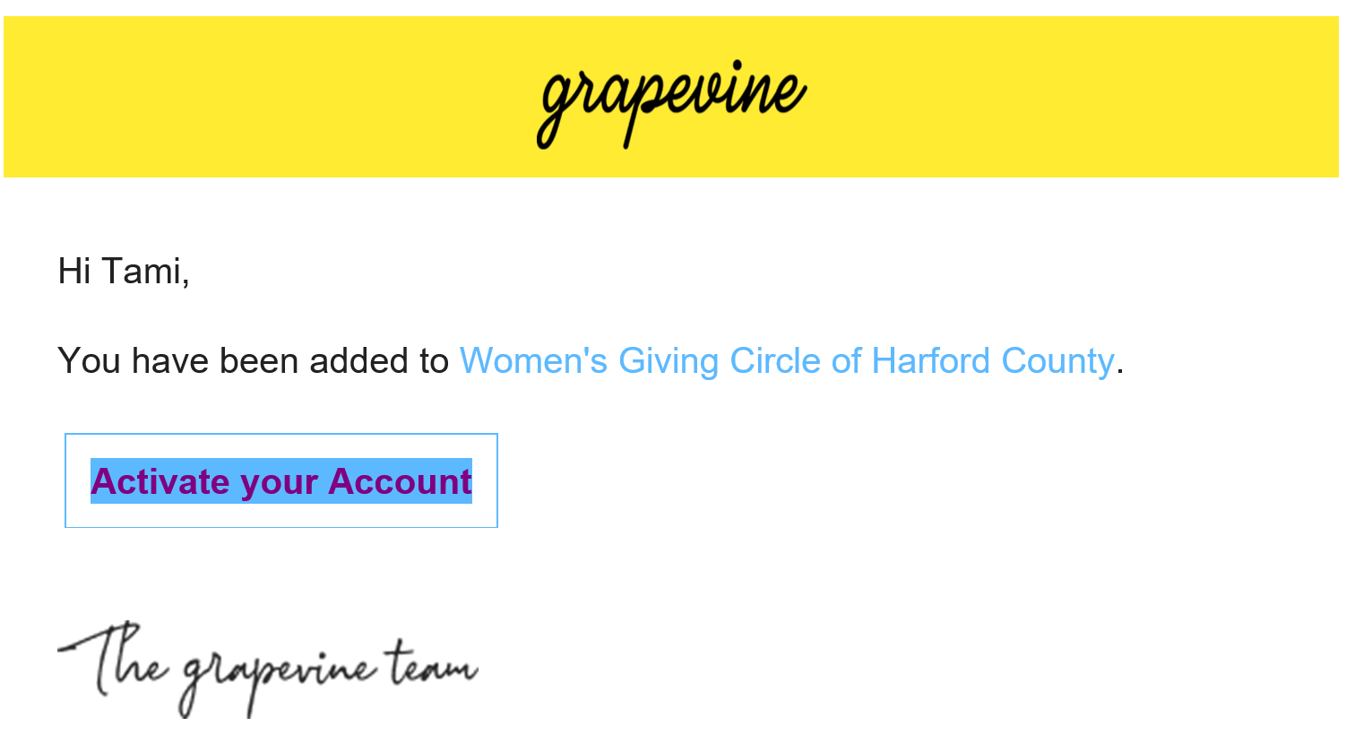
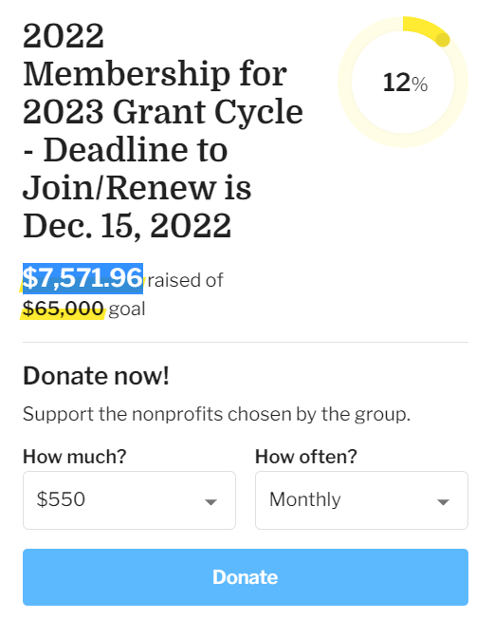
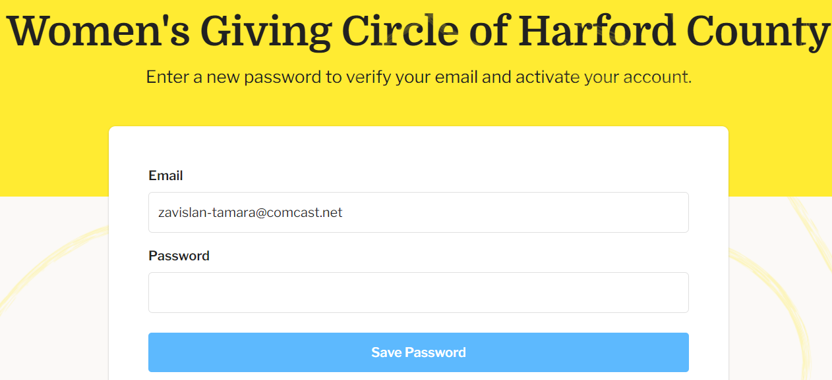
Giving Online
Step 1: Activate your Grapevine account (email invitation sent in January).
Step 3: Click on the Donate button and make your membership payment in the amount of $550/$250.
Step 2: Enter a new password.
Notes:
D2

Slide 47
Stay Connected!
Watch your inbox, our website, and the WGC Facebook page for information about upcoming events and opportunities to connect with current and prospective members!
If you’re interested in joining the Membership and Outreach Committee, send us an email at WGCHarfordMembership@gmail.com. We are always looking for engaged members to join in our efforts to strengthen the member experience!
Notes:
D2

Slide 48
Upcoming Events
Save the Date
General Membership Meeting
September 14
Meet the 2022 grantees!
Giving Tuesday Holiday Happy Hour
November 29
Announcement of the 2022 Members’ Choice Award!
Members only mix and mingle
Details to follow
Notes:
D2

Slide 49
Closing Remarks
Bonnie Miranda
Notes:
Donna introduce Bonnie

Slide 50
Notes:
Donna introduce Bonnie

Slide 51
Thank you!

